Slide 1
Electrical properties of the heart
Department of Physiology
Dr. K. Medagoda

Slide 2
Morphology of cardiac muscle
Cardiac muscle has striations similar to skeletal muscle
Each fiber is a compete unit surrounded by the cell membrane
But the muscle fibres branch and interdigitate
End of one muscle fiber abuts on another through an extensive series of folds
These areas are known as intercalated disks

Slide 3
Morphology of cardiac muscle
Intercalated disks
  Always occurs at Z lines
  Provide strong union between two fibers
  Maintain cell to cell cohesion and transmit pull of one contractile unit to the other

Slide 4
Morphology of cardiac muscle
Next to the disks membranes of the adjacent muscle fibers forms gap junctions
  Provide low –resistance bridges for the spread of the cardiac excitation
Gap junctions permit cardiac muscle to function as a electrical syncytium
The T system of is located at z lines
Has numerous mitochondria
What is the location of the T system in mammalian skeletal muscle?

Slide 5
Morphology of cardiac muscle
Intercalated disk

Slide 6
Electrical properties of the heart
Cardiac muscle is unique by having a specialized pacemaker tissue
Pacemaker tissue initiate repetitive action potentials
Heart continuous to beat even after fully denervation
Even heart is cut into pieces the pieces will continue to beat

Slide 7
Electrical properties of the heart
The resting membrane potential of individual cardiac muscle fiber is about -90 mV
Stimulation of the membrane results propagated action potential
Action potential is coupled with the contraction of the cardiac muscle
Contraction begins just after the start of the action potential

Slide 8
Cardiac muscle action potential
Cardiac action potential has 5 phases
  Phase 0
  Phase 1
  Phase 2
  Phase 3
  Phase 4
Cardiac action potential are of long duration approximately taking 300 milliseconds
Resting membrane potential is due to external K⁺ concentration

Slide 9
Cardiac muscle action potential
+20mV
Phase 1
0
Phase 2
Phase 3
Phase 0
Phase 4
- 90mV
0
300 ms

Slide 10
Cardiac muscle action potential
Phase 0 – lasts about 2ms
  It is the upstroke of the action potential
  Depolarization proceeds rapidly and an overshoot is present
  Caused by opening of voltage gated Na⁺ channels
  Results influx of Na⁺
  Magnitude of the action potential depends on the external Na+ concentration

Slide 11
Phase 1
  Is the initial rapid repolarization
  Caused by closure of Na⁺ channels
  Results decreased influx of Na⁺
Phase 2
  Is the plateau phase
  Caused by slower but prolonged opening of the voltage gated Ca²⁺ channels
  Results influx of Ca²⁺

Slide 12
Phase 3
  Is the final repolarization to resting membrane potential
  Caused by closure of Ca²⁺ channels and K⁺ efflux through various K⁺ channels
Phase 4 – resting membrane potential

Slide 13
Cardiac muscle action potential
+20mV
Phase 1-closure of Na⁺ channels
0
Phase 2 Ca²⁺ influx
Phase 3
K⁺ efflux, closure of Ca²⁺ channels
Phase 0
Na⁺ influx
- 90mV
0
300ms

Slide 14
Cardiac muscle action potential Refractory periods
Absolute refractory period (ARP)
  The cardiac muscle cannot be excited again
  Includes phases 0,1,2 and half of the phase 3
  Until the membrane potential reaches approximately -50mV
Relative refractory period (RRP)
  During the rest of the phase 3 and phase 4 cardiac muscle remains relatively refractory
  Because of this long absolute refractory period tetanization of the cardiac muscle does not occur

Slide 15
Refractory periods
+20mV
Phase 1
0
Phase 2
Phase 3
Phase 0
- 90mV
ARP
RRP
0
100 ms
200 ms
300 ms

Slide 16
Mechanical properties
Excitation–contraction coupling
  Results contractile response
  Begins just after the start of depolarization
  Lasts about 1.5 times as long as the action potential
  Activation of Ca²⁺ channels in the T system results influx of Ca²⁺
  Ca²⁺ binds to troponin and initiates contraction

Slide 17
Starling’s law of the heart
Cardiac muscle has a resting fiber length at which the tension developed upon stimulation is maximal
the initial length of the fibre is determined by the diastolic filling ( end-diastolic volume)
Tension increases as the diastolic volume increases (increasing fiber length) until it reaches the maximum
Then the tension starts to decline even with increasing fibre length

Slide 18
Starling’s law of the heart
‘The energy of contraction is proportional to the initial length of the cardiac muscle fiber’

Slide 19
The force of contraction is increased by catecholamines- positively inotropic action
  Mediated via β₁ receptors
Reduction of force of contraction-negatively inotropic action
Increase of heart rate – positively chronotropic action
Decrease of heart rate – negatively chronotropic action

Slide 20
Origin of the heart beat
Parts of the heart beat in orderly sequence
Atrial systole → Ventricular systole → diastole
During diastole all four chambers are relaxed
Heart beat
  Originates in a specialized cardiac conduction system
  Spreads via this system to all parts of myocardium

Slide 21
The cardiac conduction system
Capable of spontaneous discharge
Made up of
  Sinoatrial node (SA node)
  Intranodal atrial pathways
  Atrioventricular node (AV node)
  Bundle of His and its branches
  Purkinje system
  Under abnormal conditions even the parts of myocardium is capable of spontaneous discharge-latent pacemakers
Composed of modified cardiac muscles

Slide 22
The cardiac conduction system
The cardiac pacemaker- SA node
  Located at junction of superior vena cava with right atrium
  Discharges most rapidly
  Depolarizes other areas before their spontaneous discharge
  Its discharge rate determines the rate of heart beat
  Contains pacemaker cells- P cells
    Develops from the structures on the right side of the embryo
    Innervation is primarily through right vagus and sympathetic fibers on the right side

Slide 23
The cardiac conduction system
The Intranodal pathways
  Three bundles of atrial fibers
  Connect the SA node to AV node
Impulses generated in the SA node passes through these pathways to AV node
Conduction also occurs through the atrial myocytes but it is slow

Slide 24
The cardiac conduction system
AV node
  Located at the right posterior portion of the interatrial septum
  Is the only conduction pathway between atria and ventricles
  Continuous with the bundle of His
  Develops from the structures on the left side of the embryo
  Innervation primarily through left vagus and the sympathetic fibers on the left

Slide 25
The cardiac conduction system
His bundle
  Gives off left bundle branch at the top of the interventricular septum
  Then continues as the right bundle branch
  Left bundle branch divides into an anterior and posterior fascicle
  Branches and fascicles runs subendocardially on either side of the septum
  Continuous with the Purkinje system

Slide 26
The cardiac conduction system
Purkinje system
  Fibers spread to all part of the ventricular myocardium

Slide 27
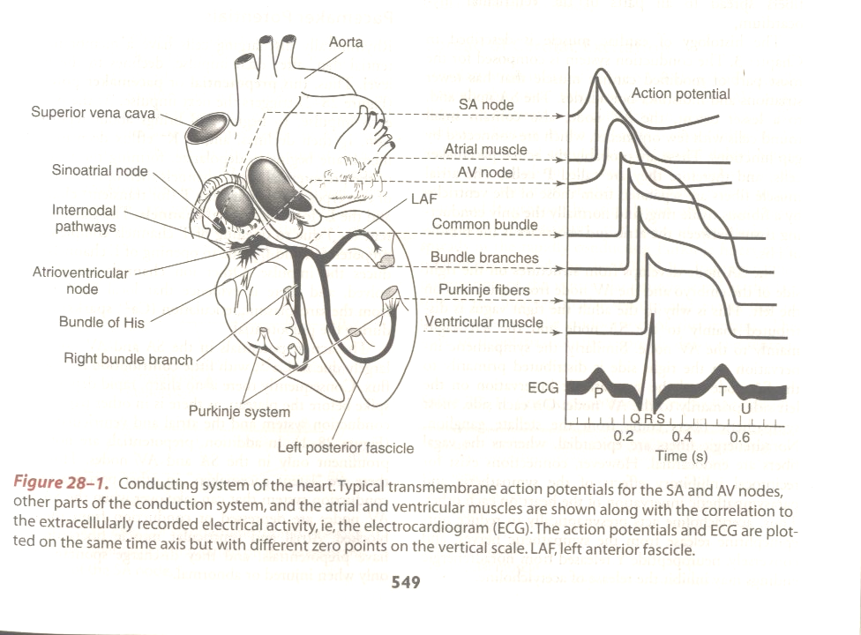
The cardiac conduction system

Slide 28
Spread of cardiac excitation
Depolarization initiated in the SA node
Spreads rapidly to through the atria
Converges on the AV node via three Intranodal pathways
AV node conduction is slow
  Therefore there is a delay of 0.1 s (AV nodal delay)
Impulse reaches the bundle of His

Slide 29
Spread of cardiac excitation
Passes to the Purkinje system
Depolarises the interventricular septum first from right to left across the midportion of the septum
The wave of depolarization then spread to apex down the septum
Activates the major portion of the ventricular myocardium from endocardium to epicardium
Finally depolarises the posterobasal left ventricle, pulmonary conus and uppermost septum

Slide 30
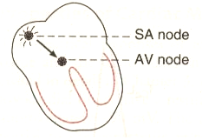
Spread of cardiac excitation
Atrial Activation

Slide 31
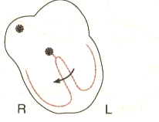
Spread of cardiac excitation
Septal depolarization from left or right

Slide 32
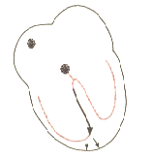
Spread of cardiac excitation
Activation of the apex

Slide 33
Spread of cardiac excitation
Depolarization of the ventricular myocardium

Slide 34
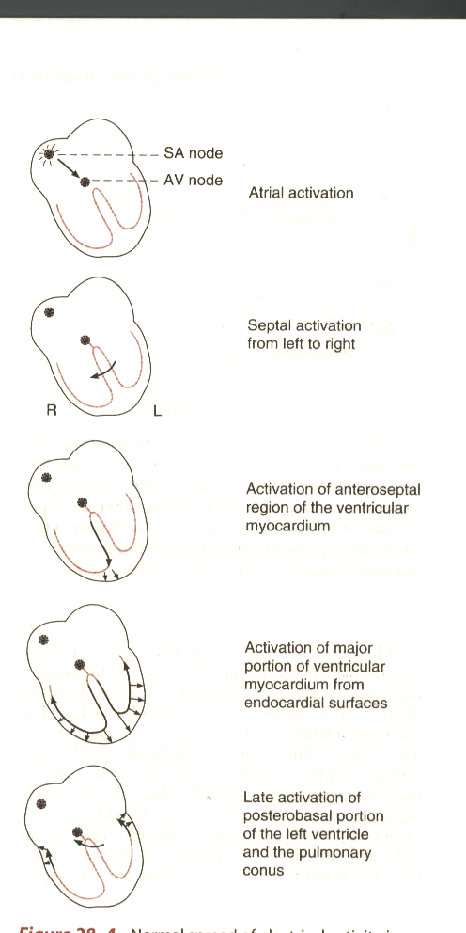
Spread of cardiac excitation

Slide 35
Pacemaker potential
pacemaker cells discharges rhythmically and spontaneously
After each impulse their membrane potential declines to firing level
This fires another action potential
This declining potential is known as Pacemaker potential or prepotential
Prominent in the SA and AV node
Can be seen in latent pacemakers also

Slide 36
Pacemaker potential-ionic basis
At the peak of the action potential
  K⁺ efflux occurs resulting outward K⁺ current
  Results repolarization
Then K⁺ efflux decreases
Membrane begins to depolarise slowly from -60 mV to -40 mV
  Forms the first part of the prepotential
Ca²⁺channels opens up resulting action potential

Slide 37
Pacemaker potential-ionic basis
mV
Action potential
K⁺ efflux
Opening of Ca²⁺ channels
0
-40mV
-60mV
Prepotential
Decrease of K⁺ efflux
Time

Slide 38
Regulation of the prepotential
Effect of cholinergic vagal stimulation
  Results hyperpolarization of the membrane
  The slope of the prepotential is decreased
  The frequency of the action potential is decreased
Results reduction of heart rate
Negatively chronotropic action
Mediates via M₂ receptors
  Increases K⁺ conductance
Digitalis decreases the discharge frequency

Slide 39
Regulation of the prepotential
Sympathetic stimulation
  Results fall of membrane potential more rapidly
  The frequency of action potential is increased
Results increase of heart rate
Positively chronotropic action
Mediates via β₁ receptors
Rise of temperature increases the discharge frequency

Slide 40
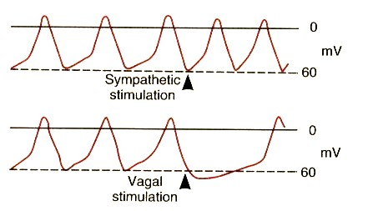
Regulation of the prepotential

